Slide 1
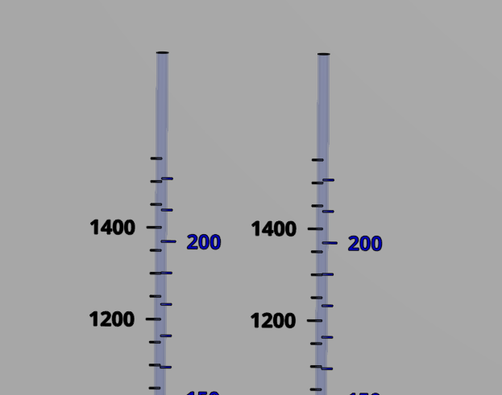
Coagulant
Chlorine
Stock tank
(L)
Calibration column
(mL)
Stock tank
(L)
Calibration column
(mL)

Slide 2
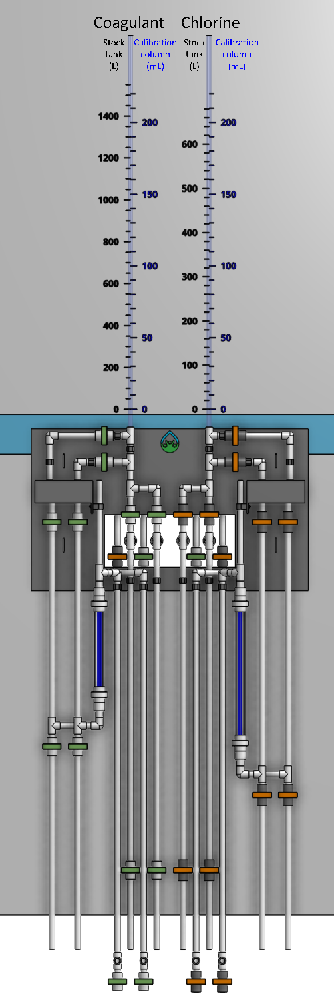

1
2
3

Slide 3
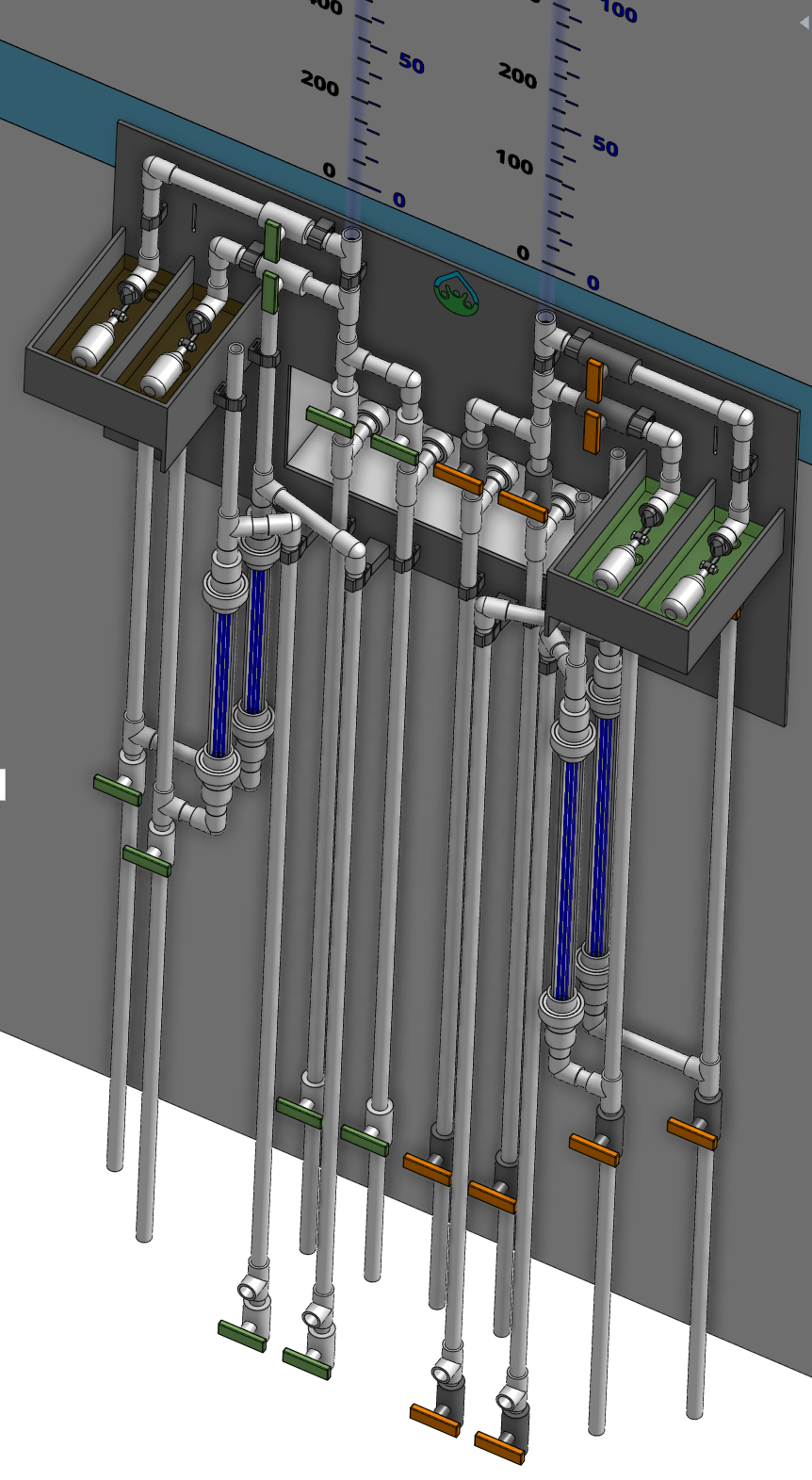
1
2
3
4
5
6
7
8
9
10
11
12

Slide 4


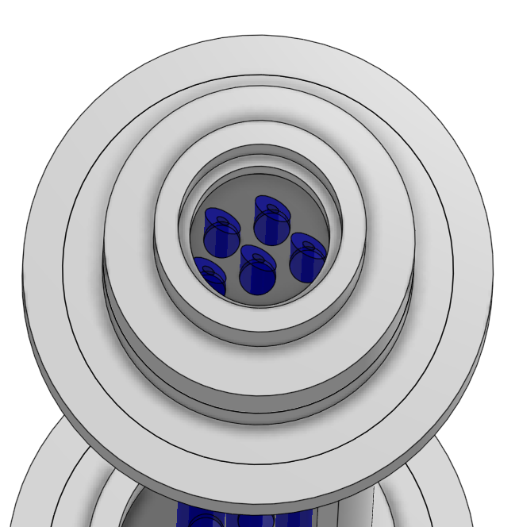
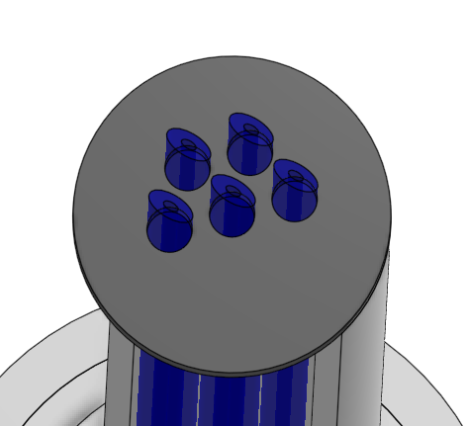
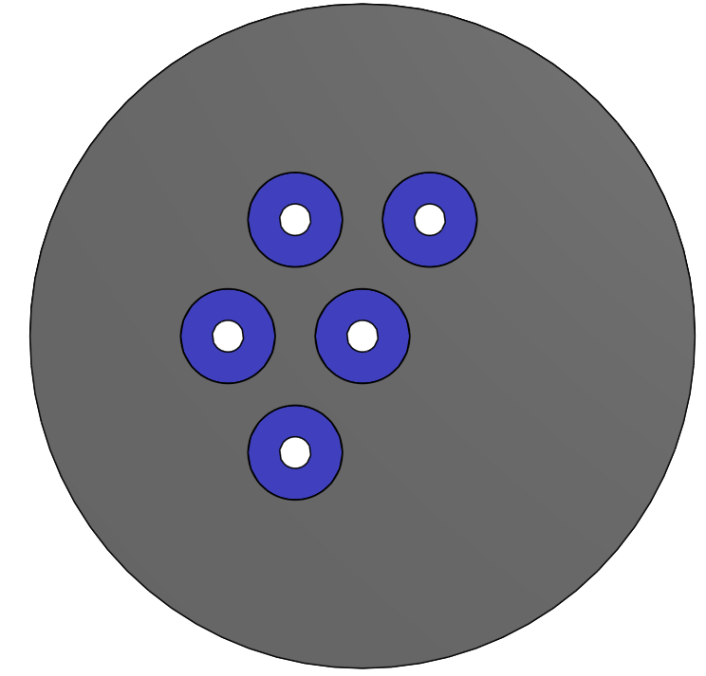
1
2
6
7
3
4
6
5
6
4

